Slide 1
Ro e-factura
Kraftanlagen expected solution

Slide 2




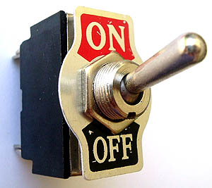
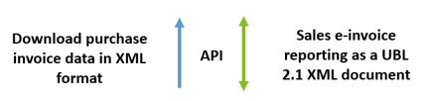
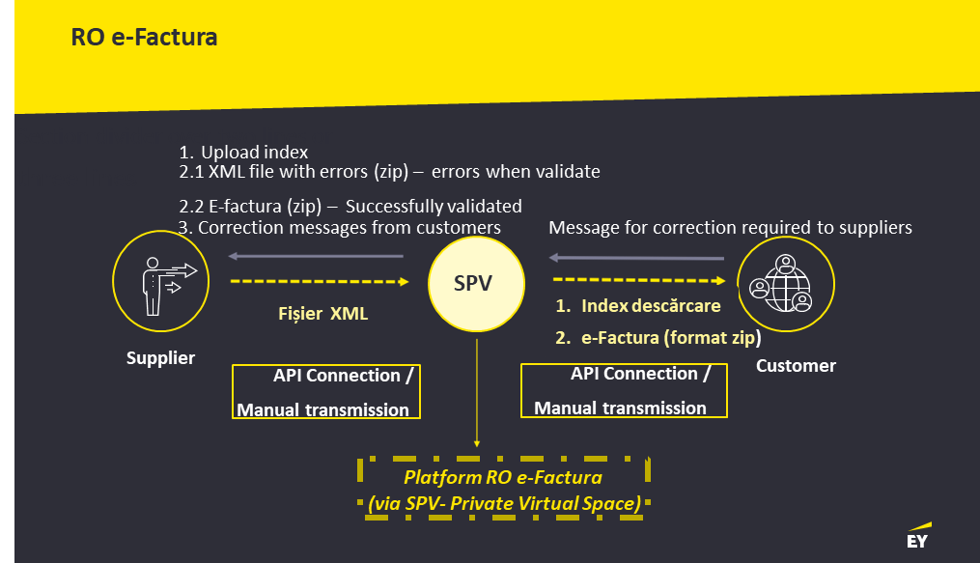
SAP match accounting with supporting docs
Auto-accounting scenario ID + complementary data
Solution architecture 2
NEW SOLUTION 2
d3 database
SAP Server
1. Apply auto-accounting scenario
2. Import XML Invoice
TIFF Invoice & docs
“Add-on” module by country code
RELEASE
Supporting documents
UPLOADS
Initiate
Intermediary approvals; attachments
Final approval
Financial review
Accounting processing:
- pick auto accounting scenario
- compile supporting documents
- convert to TIFF format; add bar code
HOLD
CONFIRMATIONS
DECISIONS
ANALYSIS
Board
Site Manager
- Contract
- Budget
- Provider info
- etc.

